Slide 1


SEICHE 2023 Intermediate Arduino Programming for IoT
Instructor: Paul Frommeyer
www.paulfrommeyer.com
Corporate Sponsor: DXC Technology

Slide 2
REMINDER YOU MUST HAVE A WORKING LED MATRIX DISPLAY TO TAKE THIS CLASS! If displays are lost or damaged, replacements are $70 with 1-week lead time for replacement

Slide 3
Lesson Plan Overview
Lesson 1: 7Feb23 – Review, Addressing, and Pointers
Overview of lesson plan
Class Exercise: Validation of sketch uploading
Class Exercise: Validation of binary create and upload
More on the Preprocessor
Memory Organization and Variables
Review of addressing and pointers
Using pointers to variables
Declaring pointers in function calls
Call-by-value Function Calls
Call-by-reference Function Calls
Lesson 2: 14Feb23 – More Gory Details
Class Exercise: Call-by-reference variables
Introduction to Complex Data Structures
Using complex data structures
Storage declarations and Arduino
Lesson 3: 21Feb23 – Fonts Redux
MD_Parola library font usage review
The MD_Parola font format
Designing your own fonts
Declaring your own fonts
Using your own fonts with MD_Parola
Lesson 4: 28Feb23 – Intro to Visual Studio Code
Introduction to VSC
https://code.visualstudio.com/docs/introvideos/overview
VSCode Installation
VSCode Integration with Arduino and ESP8266
Lesson 5: 7Mar23 – Filesystems
Introduction to mass storage filesystems
The SD FAT, FAT16, and FAT32 filesystems
The exFAT filesystem
Introduction to SPIFFS
Class Exercise: Using SPIFFS
Lesson 6: 21Mar23 – WiFi
Review of WiFi technology (but no gory details)
Class Exercise: Review of WiFi access with WiFi Manager
Web server and client HTTP architecture
Introduction to HTML
Creating a basic ESP8266 web server
Lesson 7: 28Mar23 – Web Technology
More on HTML tags
HTTP and Mime Types
Using SPIFFS
Class Exercise: Display A Web Page
Lesson 8: 4Apr23 – Doing More With Web Servers
HTML Form Data
Asynchronous Web Server Installation
Class Exercise: Displaying Sensor Data With Async Web Server
Class Exercise: Retrieving Form Data with Async Web Server
Lesson 9: 11Apr23 – Internet Access
Class Exercise: Displaying form data with MD_Parola
Obtaining information from an Internet web page
Obtaining weather information from the Internet
Class Exercise: Displaying weather information
Lesson 9: 11Apr23 – IoT Messaging and MQTT
Introduction to IoT network messaging and MQTT
Subscribing to an MQTT service
Publishing to an MQTT service
Class Exercise: Using MQTT and WiFi
Lesson 10:18Apr23 – Version control and Git
The need for document version control
The Git version control system
Installing Git
Using Git
Introduction to Github
Using Github
Class Exercise: Signing up for a Github account

Slide 4

Flash Drive Contents Reminder
When I update parts of your flash drives, you can either recopy the entire section, or just copy the updated part.
However, you will need to explicitly copy any new files so that they are locally accessible on your laptops
Copying just lesson files will– wait for it!– copy only the lesson files.
Make certain you have copied everything in RED! You should already have previously copied everything else!
FLASH DRIVE
IntermediateProgramming-Software
Archive–BasicProgrammingWith Arduino-Fall2022
Archive-IntroductionToArduino-Spring2022
IntermediateProgramming-Software
IntermediateProgramming-Lessons
IntermediateProgramming-Documentation
ESP8266FS-0.5.0.zip
IntermediateProgramming-Lessons
IntermediateProgramming-Documentation
IntermediateProgramming-Lesson1
IntermediateProgramming-Lesson2
IntermediateProgramming-Lesson3
IntermediateProgramming-Lesson8
ArduinoReference
Beginning C for Arduino, 2nd Edition
BoardsGuides
D1 Mini Reference
ElectronicsReference
IoT Reference
LED Matrix Display Architecture
HackSpace Magazine
Can’t do reading homework without the files!

Slide 5
Lesson 8 – More With Web Servers
Part A
HTML Forms
Synchronous vs Asynchronous Code
Part B
Async Webserver Installation
Class Exercise: Displaying Sensor Data On Web Page
Class Exercise: GETting Form Data from Web Pages

Slide 6
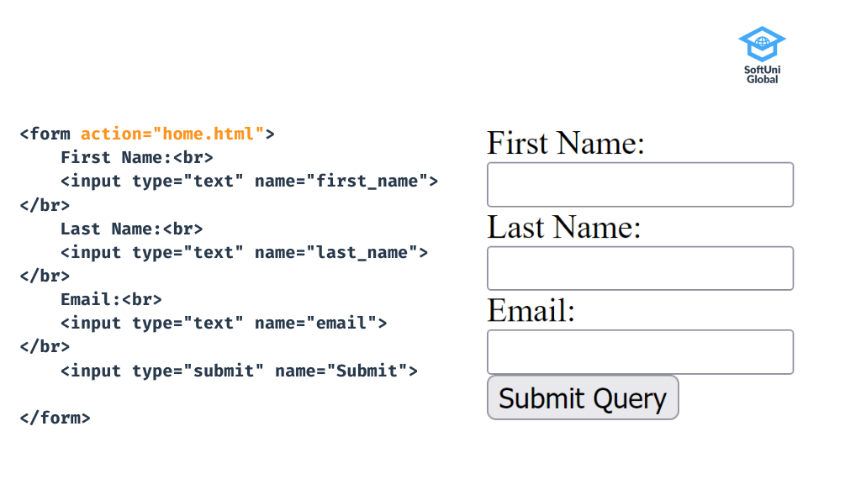
HTML Form Structure
HTML has input elements displayed in different ways such as input field, checkbox (for selecting zero or more of multiple choices), radio buttons (for selecting one of multiple choices), submit button etc.
The basic structure of a form consists of input fields and a submit button.
The user fills out the input fields with the required information and upon clicking the submit button the data is sent to a form handler.
Typically, the form handler is a file on the server with a script for processing input data.

Slide 7
HTML Form Actions
You add an action attribute to the form to define where the submitted data goes. In the example above the submitted information will be handled by the script of the home.html document.
In this case, the URL is called relative. Relative URLs are compared to the current URL that is loaded in the Web browser. We can use slashes and the “double dot” notation to address a different folder or the parent folder of the virtual folder structure on the Web server.
Full URLs are used to submit the form data to completely different Web site. For example, a Web site may embed an HTML form for newsletter subscription which submits its form fields to an external Web site, which provides email newsletter services.

Slide 8
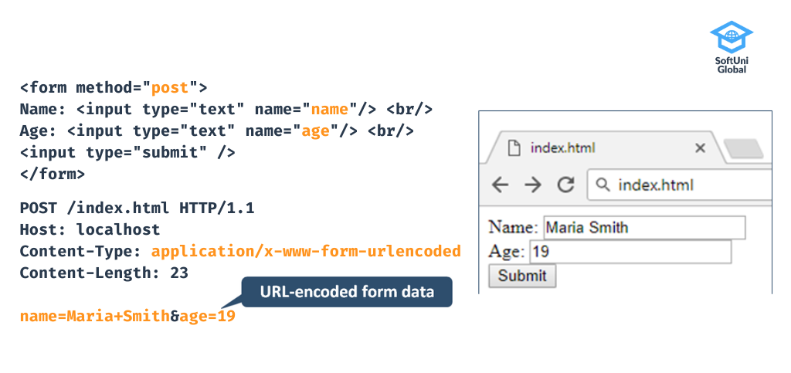
HTML Form Methods
In this example, an HTTP method attribute has been added to the form. Here again, the method can be either GET or POST. Both methods are used to transfer data from client to server.
The GET method transfers data in the URL with a query string. Therefore, the length of the URL is limited. GET is preferable for images, word documents or data that does not require any security.
POST is an HTTP method that encodes form data in a specified format (using MIME types, natch) and sends it to the server via the HTTP message body. The World Wide Web frequently uses POST to send user-generated data or an uploaded file to the web server.
In the example below, you can see the standard URL encoding used to encode the HTML form fields and URLs. The URL encoding is a long string of name and value pairs. Each pair is separated from one another by an ampersand (&) sign and each name is separated from the value by an equals (=) sign. For example: key1=value1&key2=value2.
This encoding can be used for text and other data fields, but it does not support file upload fields. We can overcome this limitation by switching to multipart encoding.
Page HTML
HTTP POST data stream
HTTP GET in URL

Slide 9
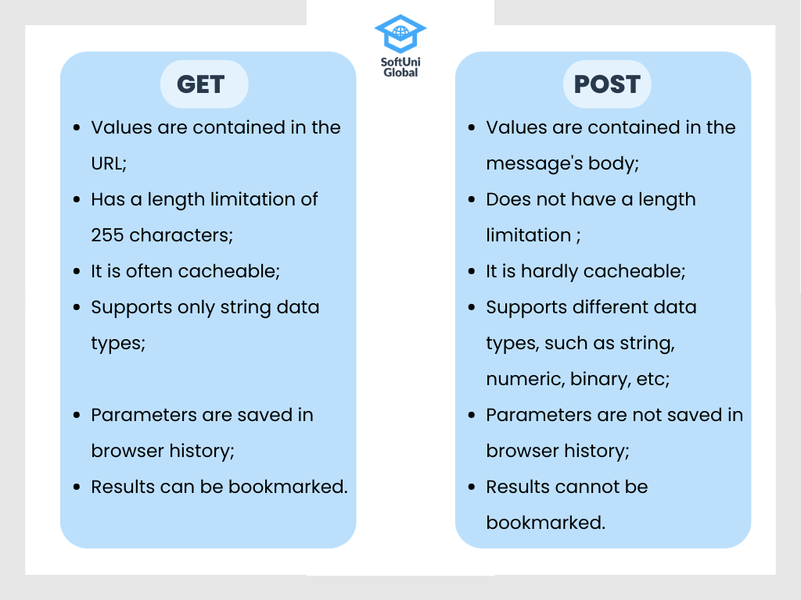
Differences Between GET and POST
If you want to send one or two simple variables (for example search parameters) to your server, then you use GET. However, if your form includes passwords, credit card information, or any other data that needs extra protection then POST is a better choice.

Slide 10
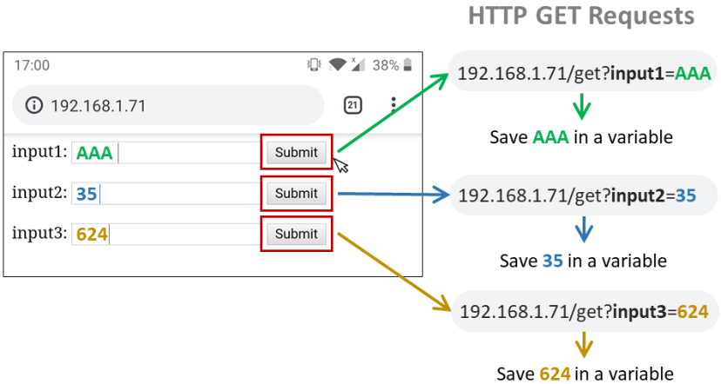
HTML GET Forms
As mentioned previously, the GET HTTP data transfer can be used to send form data from a client browser to a server
This is done by including the data within a URL.

Slide 11
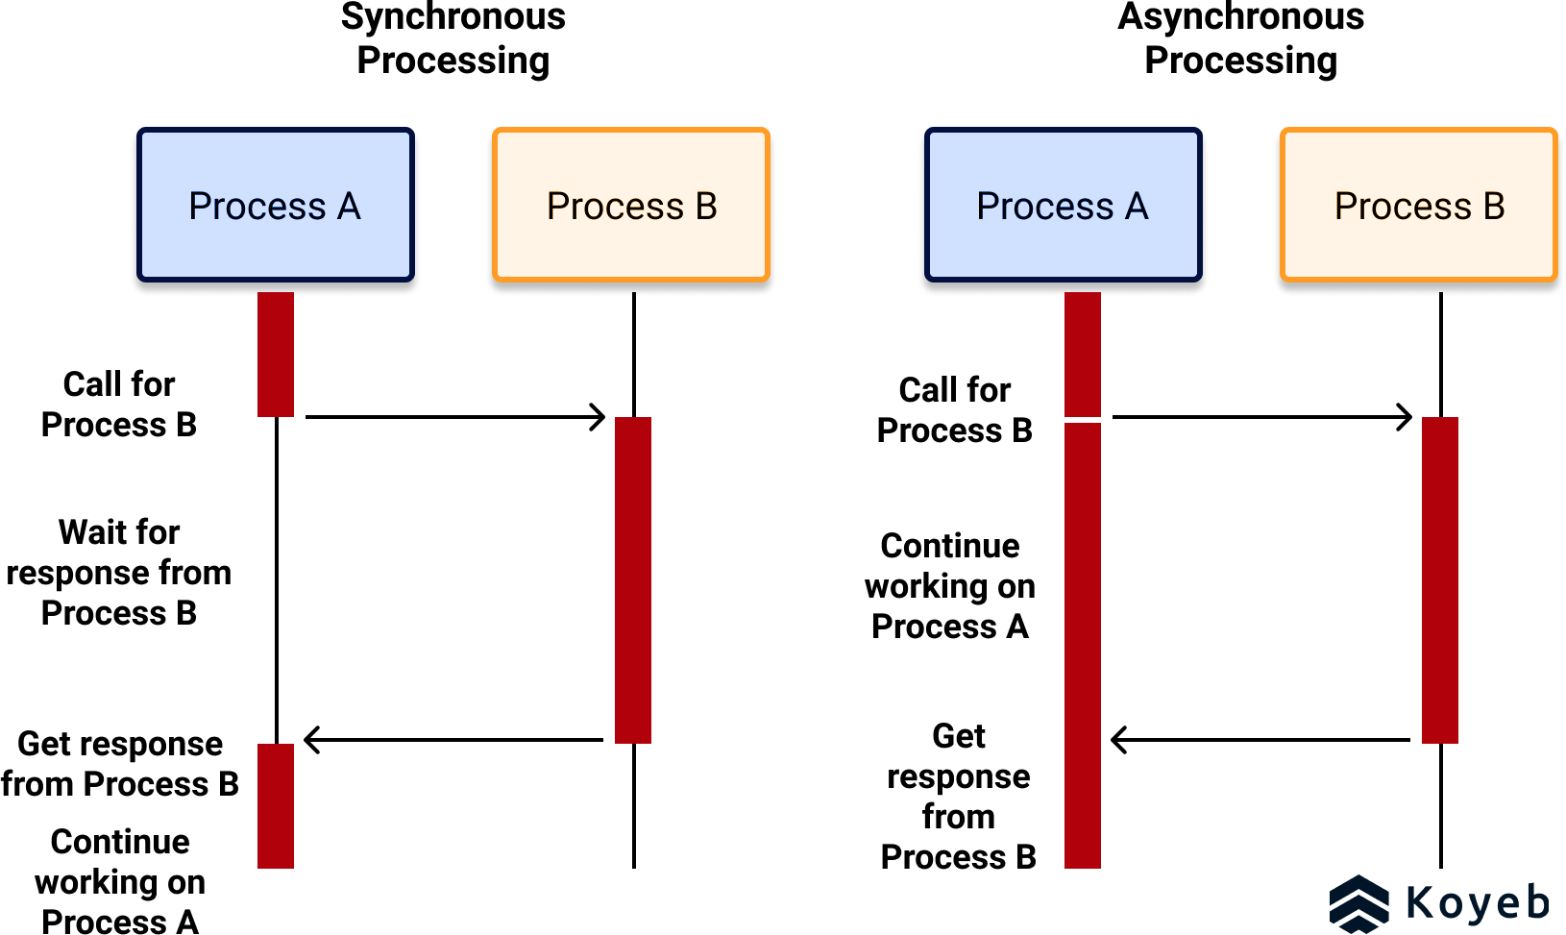
Synchronous vs Asynchronous
In synchronous processing, one action must wait for another
In asynchronous processing, actions can proceed in parallel

Slide 12
Async Web Server Installation
The ESP8266 Asynchronous Web Server is faster and more efficient, and nearly all on-line projects use it instead of the single-threaded (synchronous) server included by default in the ESP8266 wifi library
So, we will need to install the necessary libraries for the Async server before we can use it. However, this time we must perform the installation manually!
Open your SKETCH8A folder in your file browser (Explorer or Dolphin)
Copy the AsyncTCP and ESPAsyncWebServer folders
Next, navigate to your own Arduino folder in your home directory:
C:\Users\YourUserName\Documents\Arduino [Windows]
/home/seiche/Arduino [Kubuntu Linux]
Then open the libraries folder
Now paste the two folders that you previously copied (to the file explorer clipboard) into the libraries folder

Slide 13
Class Exercise 8A: Display Sensor Data
Go ahead and load SKETCH8A, but do not upload it!! First, upload the SPIFFS data. THEN send the sketch to your displays. Open the serial monitor to obtain the IP address assigned by the wifi, then surf to that IP in your browser.
Remember, you probably cannot do a SPIFFS upload with Serial Monitor open
Note: I already adapted the sketch for our BMP180 sensors, which do not provide humidity readings
You should see a page similar to that on the right, showing the various retrieved sensor values and their derived values.
BMP180 has not humidity return value; it’s coded to all 9’s in the sketch
Also, your page may or may not control your LED depending on your browser, as this example includes JavaScript
More gory details here: https://randomnerdtutorials.com/esp8266-bme280-arduino-ide/

Slide 14
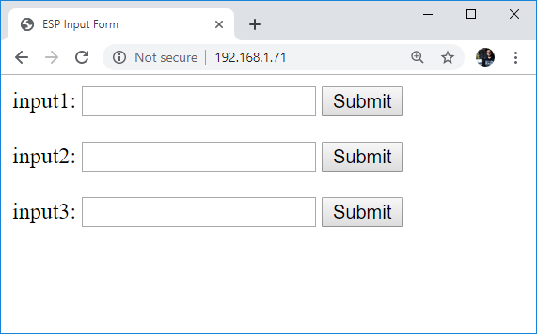
Class Exercise 8B: Get Webserver Input
Go ahead and load SKETCH8B, and send it to your displays. Use the serial monitor to obtain the IP address assigned by the wifi, then surf to that IP in your browser
<form action="/get"> input1: <input type="text" name="input1"> <input type="submit" value="Submit"> </form>
At left is the HTML used to generate the first form field and its button widget. Note the action method, input type, and form type
You should see a page similar to that on the right, with three input fields and three separate submit buttons
Observe the SerialMonitor when you enter text into a field and then click the corresponding “Submit” button widget
More gory details here: https://randomnerdtutorials.com/esp32-esp8266-input-data-html-form/

Slide 15
Formal End of Lesson 5
HOMEWORK
No Homework This Week
In next week’s exciting episode
Review of WiFi technology (but no gory details)
Class Exercise: Review of WiFi access with WiFi Manager
Uploading a web page using SPIFFS
Class Exercise: Create a basic web server

Slide 16
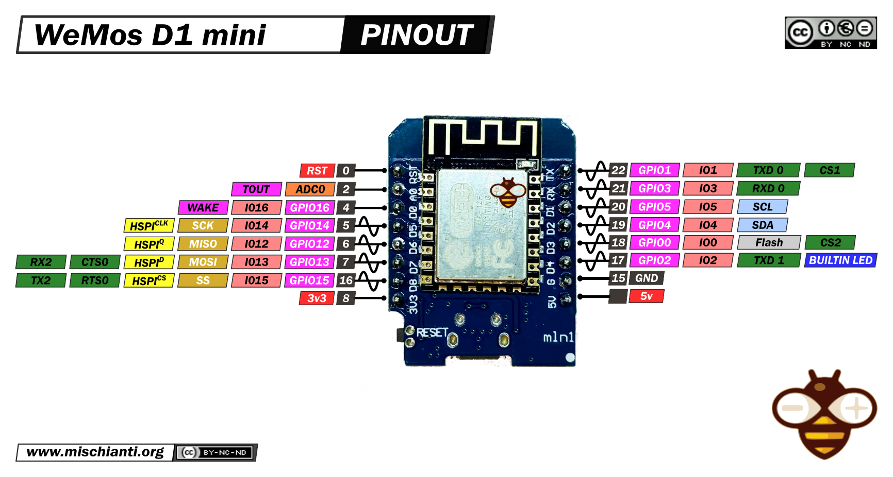
Our Microcontroller: The WeMos D1 Mini
Hilights
11 digital IO: all are interrupt and pwm capable (except D0/GPIO16)
1 analog input (3.2V max input): A0/ADC0
Micro USB or Type-C USB Port (clones usually have micro USB)
Two SPI interfaces (one is used for on-board flash memory), one I2C interface, two serial ports
Built-in WiFi (client or standalone access point modes) and Bluetooth
Compatible with MicroPython, Arduino, NodeMCU
Uses the CH340 USB-to-serial driver (installation usually needed on Windows)
Extremely low cost (approx $3.00 US on Amazon; one of the two least expensive components in your kits)

Slide 17
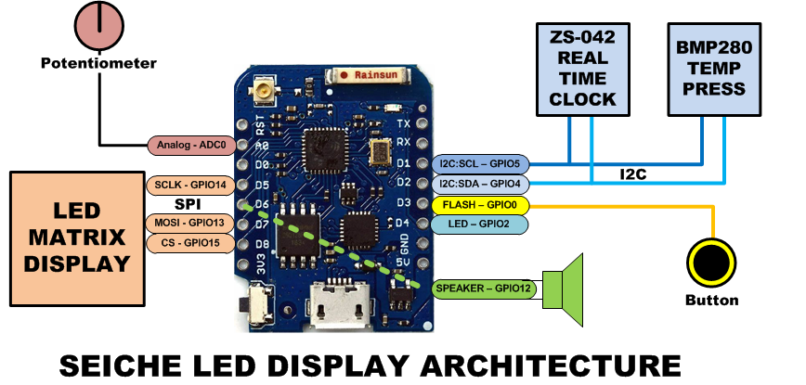
SEICHE LED Display Architecture
Red MAX7219 8x32 LED matrix display (SPI)
ZS-042 real-time clock module (I2C)
BMP280 Temperature and Pressure Sensor (I2C)
Piezoelectric speaker (PWM)
10KΩ Potentiometer (Analog-to-Digital Converter)
Button (Pullup and interrupt)

Slide 18
sprintf() Function Syntax
sprintf()’s formal syntax is: sprintf(char *buffer, const char *format, variable list)
buffer is an array of type char (the parameter when passed can also be a pointer [address] for such an array) which will contain the formatted output of the function
format is an unmodifiable (constant) array of char containing the format descriptors for all variables subsequently passed to the function, which is to say, it’s the format string.
The variable list are just the comma separated variables that are to be formatted
All variables passed in a single call to sprintf() are combined into a single output string
sprintf() automagically puts a terminating NULL (\0) at the end of the ASCII output

Slide 19
sprintf() Format Strings
sprintf() format strings contain conversion specifiers that specify how each individual variable is to be converted
sprintf() conversion specifiers have the following general syntax (all begin with a percent-sign):
%[flags][minimum field width][.][precision][length][conversion character]
% - special token that indicates the start of a conversion specifier
Flags – these modify the behavior of the specification
Minumum field width – as it says on the tin; this the minimum number of characters to be converted
. – The period is a separator between field width and precision
Precision – means one of the following depending on the variable type and conversion specifier
The maximum number of characters to be generated from a string
The number of digits after the decimal point for type float conversions (e, E, or f)
The zero-filled minimum number of digits for an integer
Conversion character – A single character which determines the output type of the conversion specifier; a single character that specifies the type of output format for the corresponding data or variable

Slide 20
sprintf() Conversion Specifiers
Below are the general conversion specifiers and what they do.
Specifier | What it does
d, i | int - integer; signed decimal notation
o | int – unsigned octal (no leading zero)
x, X | int – unsigned hexadecimal, no leading 0x
u | int – unsigned decimal
c | int – single character, after conversion to unsigned char
s | char * - characters from string are printed until \0 (NULL) or precision is reached
f | double – decimal notation of form [-]mmm.ddd where number of decimals is specified by precision; precision of zero (0) suppresses the decimals altogether
e, E | double - exp notation; default precision of 6, 0 suppresses
g, G | double – Use %f for <10^4 or %e for >10^4
p | void * - print output as a pointer, platform dependent
n | Number of characters generated so far; goes into output
% | No conversion, put a % percent sign in the output

Slide 21
sprintf() Conversion Specifiers
Below are the flags and what they do.
Flag | What it does
- | Left justification
+ | Always print number with a sign
spc (space) | Prefix a space if first character is not a sign
0 (zero) | Zero fill left for numeric conversions
# | Alternate output form depending on conversion character o – first digit will be zero x or X – 0x or 0X (respectively) prefixed to non-zero results e, E, f, g and G – Output will always have a decimal point g and G – trailing zeroes will never be removed

